Slide 1
Ashutosh J.
Lead Vocalist & Guitarist
IT Support Specialist
NurseYou
Team Name: Brute.Force.Cares, Team Number: 7,
Team ID: 4403908, Team Members: Ayush(c), Devansh, Elio
Campus Name and Batch: Vellore Institute of Technology, 2022 Batch

Slide 2
NurseYou – An all in one health kit to nurse you right at your home
Problem statement: In the healthcare system, patients often must deal with issues of approachability, availability and affordability when it comes to receiving care at hospitals. In some cases, the patients are required to travel long distances multiple times in a month for treatments and tests. Often these travels get difficult to plan and manage, as, about 28 percent of older adults in the United States live alone. In some other cases patients avoid hospitals and miss getting proper care due to the cost. A 2018 report says 64% Americans have avoided or delayed medical care in the last year due to expected costs. Even when a patient can receive care, things can go wrong as it is becoming more and more difficult for hospitals to provide proper care owing to physician burnouts and shortage of nurses.
Team Profile:
Team Name: Brute.Force.Cares, Team Number: 7,
Team ID: 4403908, Team Members: Ayush(c), Devansh, Elio
Campus Name and Batch: Vellore Institute of Technology,
Team Name: Brute.Force.Cares, Team Number: 7,
Team ID: 4403908, Team Members: Ayush(c), Devansh, Elio
Campus Name and Batch: Vellore Institute of Technology, B.Tech. 3rd Year 2022 Batch

Slide 3

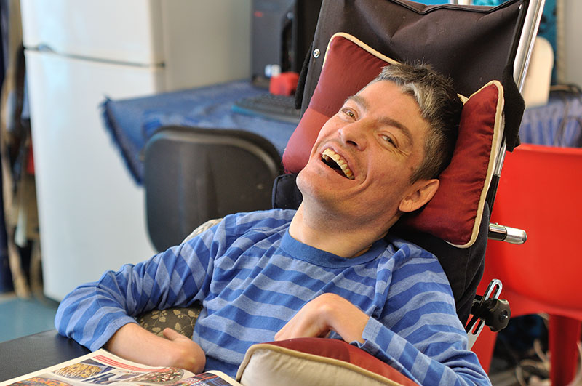
Robocare Android App
PROBLEMS:
1. Patients faces issues of approachability, availability and affordability when it comes to receiving care at hospitals.
2. Even when the patient can receive care, things can go wrong as it becomes more and more difficult for hospitals to provide proper care owing to shortage of nurses and doctors.
3. Also many patients like senior citizens, with cerebral palsy, paralyzed needs 24/7 care as they cannot communicate because of physical disability. But most of the people cannot afford it due to the higher cost.
4. Due to this reason they often land to bad healthcare which lead to other serious problems like exposure to allergic food.
5. Unavailability of fitness apps and programs
6. Mobility assistance
7. Unavailability of emergency alarms
An elderly cerebral palsy patient

Slide 4
Robocare Android App
Our app is powered by an IoT device, an image processing algorithm, and AI. This app can act as a monitor for patients at home who are suffering from illness and require special attention from caretakers/guardian and doctors at home.
Our App keeps the track of patient’s health factors like (BODY TEMPERATURE AND HEARTBEAT) for doctors and patients’ caretakers at home, which are monitored using hardware IoT sensors. also we have built a robot to transfer essential good to patients keeping social distancing in mind (Due to COVID19) which moves following gestures by hand. Also this can be used as a wheelchair for week senior citizen patients and cerebral palsy people with paralysis. And in final touch we devised an Image learning algorithm which is connected to the firebase cloud storage and give alerts in app when the patient make face gesture, or when there is a DROOLING action in cerebral palsy patients, to call for help since they can’t speak distinctly and moving their mouth, or a simple gesture will do good for these patients.

Slide 5
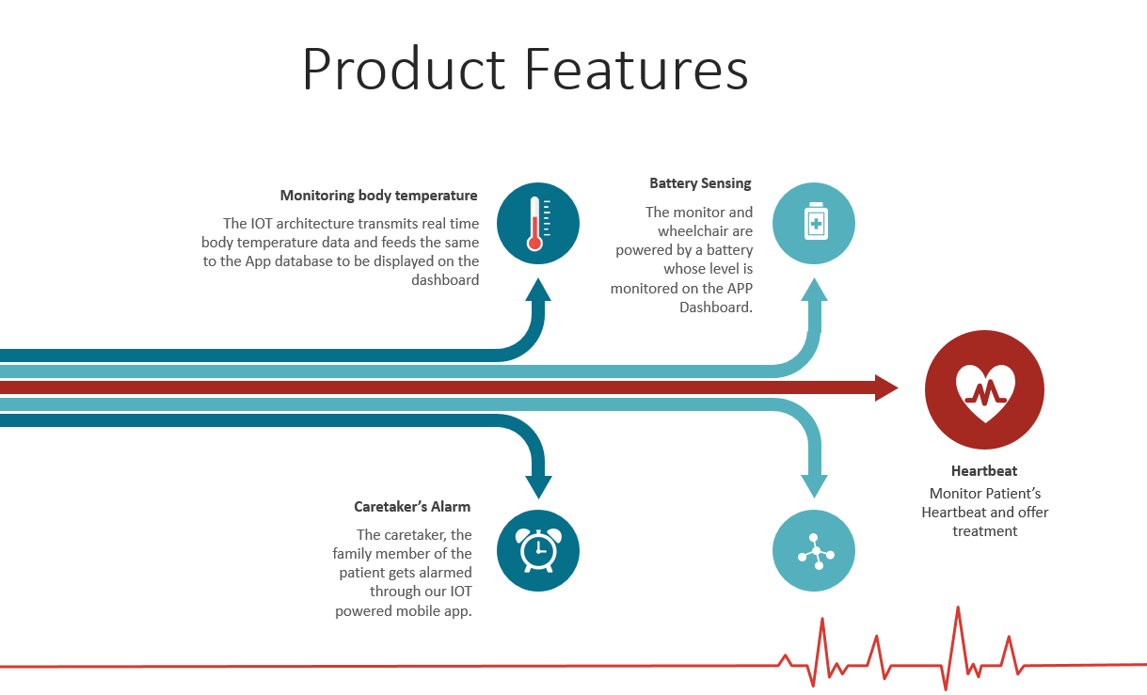

Slide 6
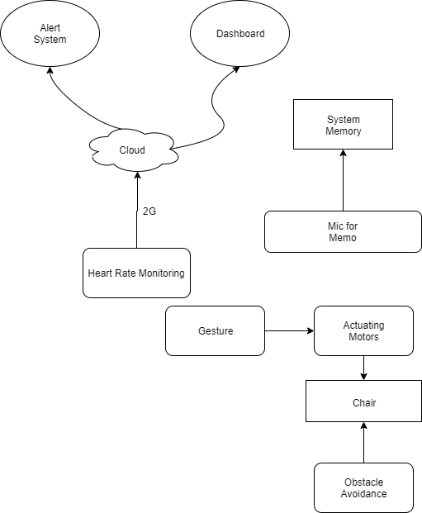
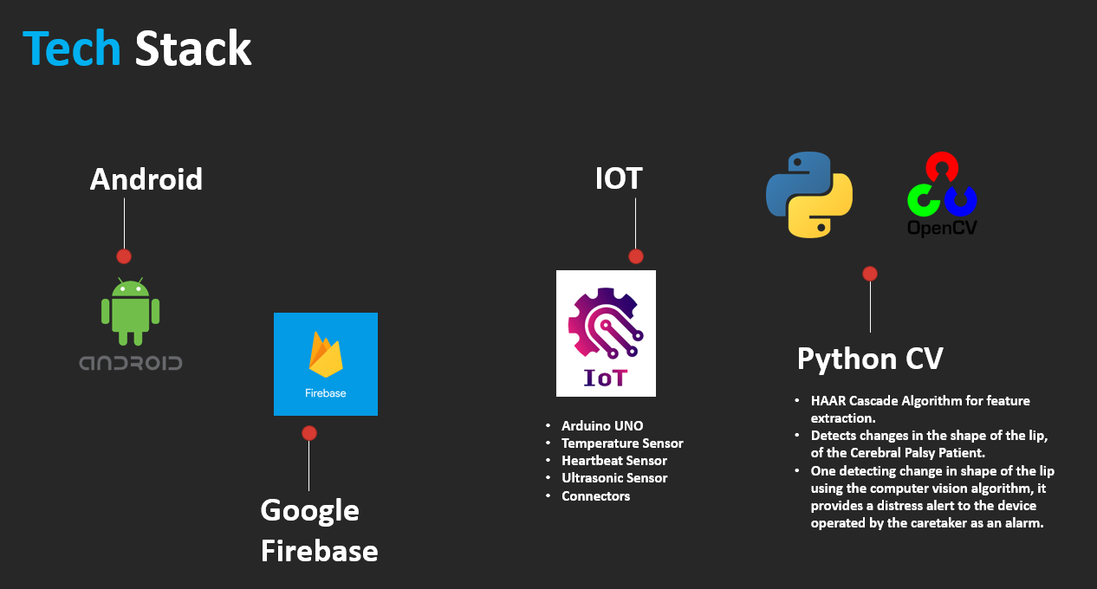
Architecture of the Robocare

Slide 7
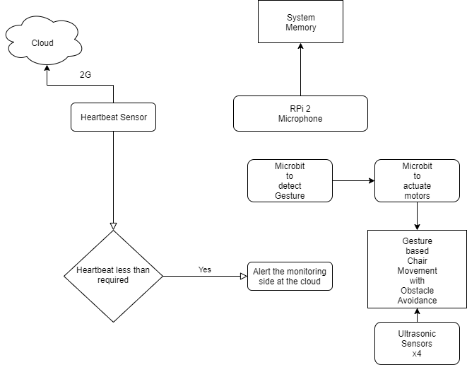
Architecture of the Robocare

Slide 8
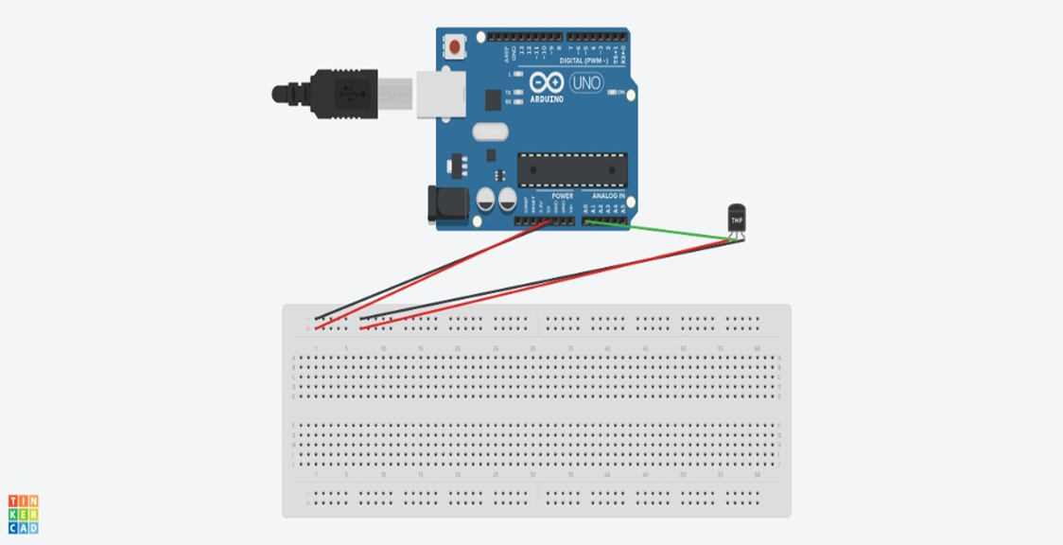
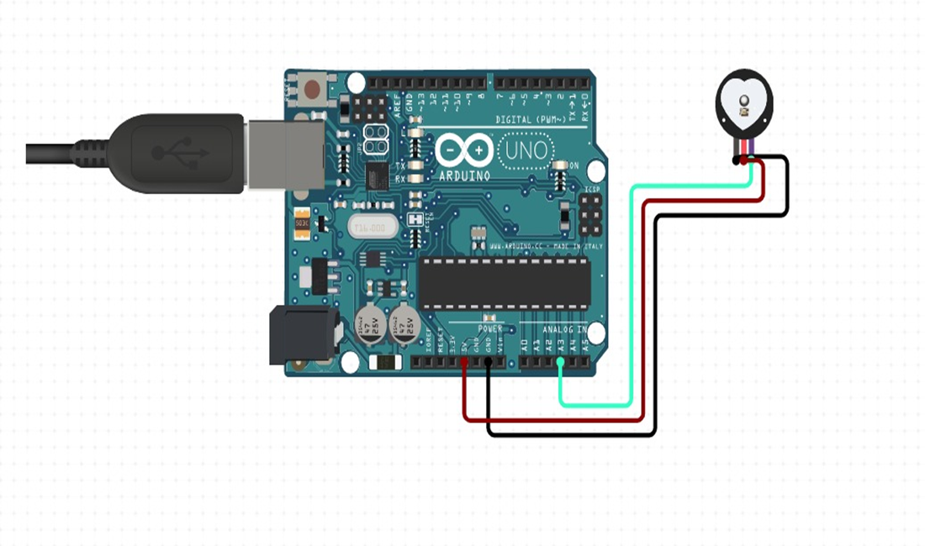
Temperature sensing device’s setup:
We are using an ESP8266 microcontroller to connect the device with the cloud and with the image processing system. And our app is also connected with the same cloud storage so if patient will make gestures, an alarm will ring in the app. Also the temperature and heartbeat reading will be sent to cloud in real-time basis and all of this will be available in our app through which doctor can make report of patients following social distancing.
Heartbeat/pulse monitoring device’s setup:

Slide 9
We are using an ESP8266 microcontroller to connect the device with the cloud and with the image processing system. And our app is also connected with the same cloud storage so if patient will make gestures, an alarm will ring in the app. Also the temperature and heartbeat reading will be sent to cloud in real-time basis and all of this will be available in our app through which doctor can make report of patients following social distancing.

Slide 10
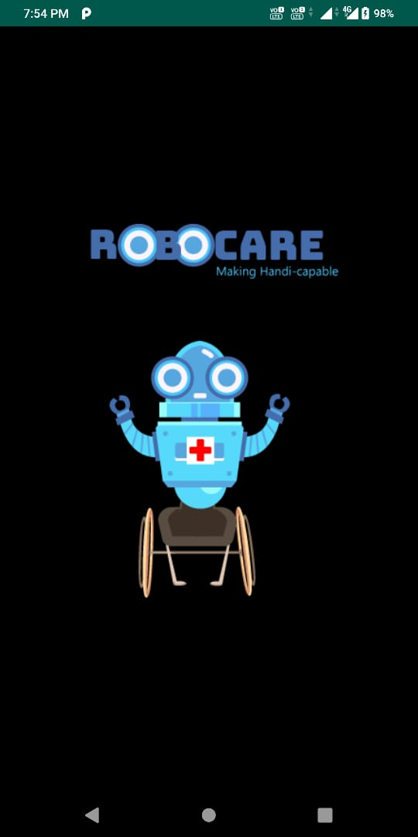
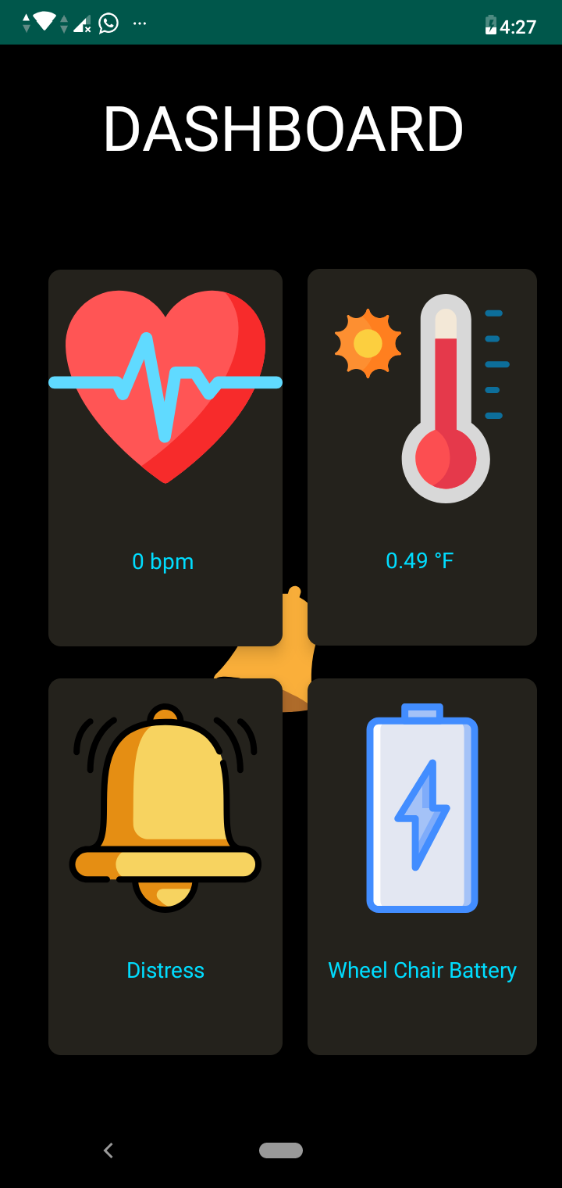
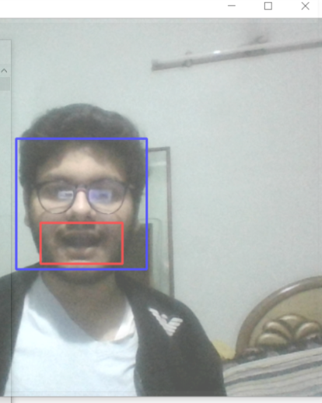
lsy patients
Dashboard to display patient heartbeat, body temp, distress alarm in real time, monitored continuously by hardware mounted on the wheelchair or place of rest
Mouth open detection during drooling/distress in cerebral palsy patients, triggers the distress alarm.
Splash screen

Slide 11
Alarm system feature in Robocare app
An alarm is sounded to the caretaker/doctor using the app.
When the heartbeat/pulse crosses a threshold.
When the body temperature is above the normal body temperature
When the patient shows signs of distress monitored by a camera and detected by image processing algorithms and AI detecting (open mouth gesture) which indicates drooling in cerebral palsy patients and discomfort in elderly handicapped people.

Slide 12

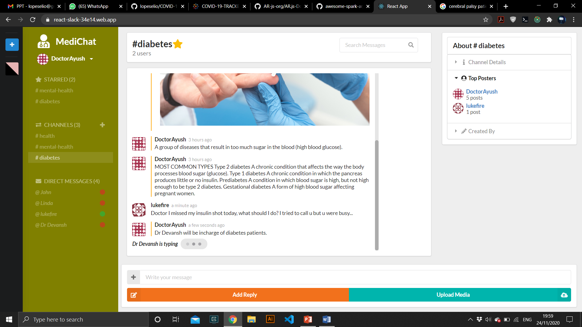
MediChat – A Slack for patients and doctors
(Website)

Slide 13
MediChat – A Slack for patients and doctors
(website)
Med-Chat - A remote realtime chatspace for patients and doctors made with ReactJS, Redux, React-Semantic-UI, web-Sockets & Firebase. This tool comes handy when doctors are taking care of a large number of patients and shared communication between the patient and the doctor can take place remotely.
Problems faced:
India facing shortage of 600,000 doctors, 2 million nurses: Study
High out-of-pocket medical costs to the patient are compounded by limited government spending for health services, according to the report by the Center for Disease Dynamics, Economics & Policy (CDDEP) in the US
Due to the pandemic, a large number of people are not able to travel to the medical facility. Also due to the shortage of nurses, there are not enough caretakers for patients at home especially the elderly/children in remote areas.
Doctors can handle countless phonecalls, and attend each patient personally.

Slide 14
What we provide ?
We provide a common platform for doctors and nurses to form health groups/channels like diabetes, mental health, COVID-19, etc so that patients suffering from a common disease can signup and meet doctors from differnet parts of the country and the world and seek medical advice.
We also provide a private chat feature where the patients can personally message other patients, doctors as private chat and get their personal health, problems solved.
Thus with this system we can raise a general health awareness among the population of the country which can help curb or prevent the spread of viruses and other infections by seeking medical guidance from health experts.

Slide 15
Features we provide:
1. Register and Login
2. Create channels for health and discuss important health issues.
3. Share health tips, prescriptions, directions for medication, etc
4. Chat privately
5. upload media in JPG, PNG format, can be used to share medicine photos, prescriptions, etc.
6. Star your favorite channels for referring and using later
7. Change your avatar and also see if the other users are available(online) for chat, so that the patients can solve their health issues online in real time.
8. See message timestamp and elapsed time of conversation
9. Auto scroll using Search feature to see and previous messages, newest conversations
10. Support for patients with Color Blindness : Our UI also allows patients to change the primary and secondary UI colors so that they can clearly distinguish between the elements present in the UI and choose an interface with colors friendly to the eye.

Slide 16
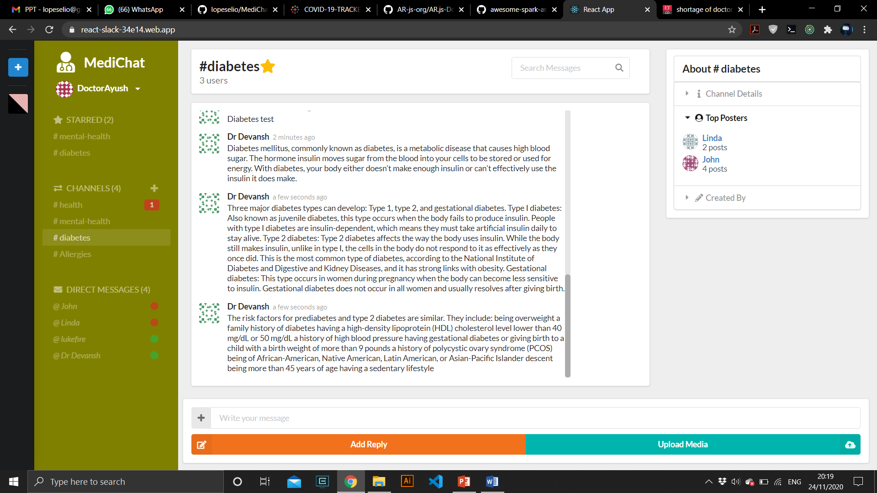
MediChat – A Slack for patients and doctors
Share valuable health insights and message doctors directly and seek maximum help.

Slide 17
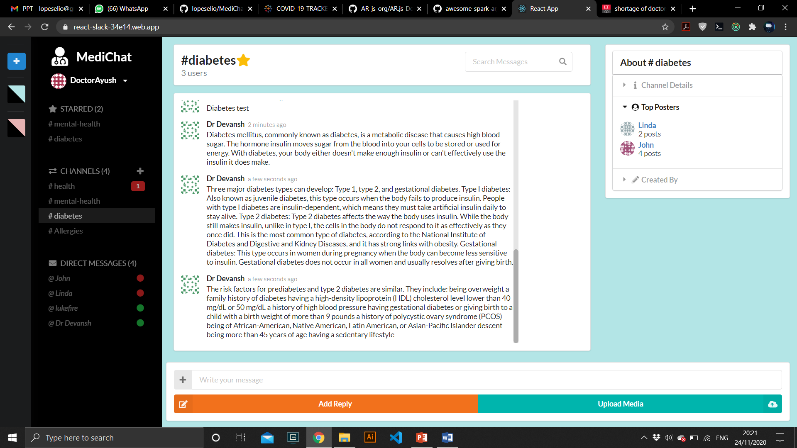
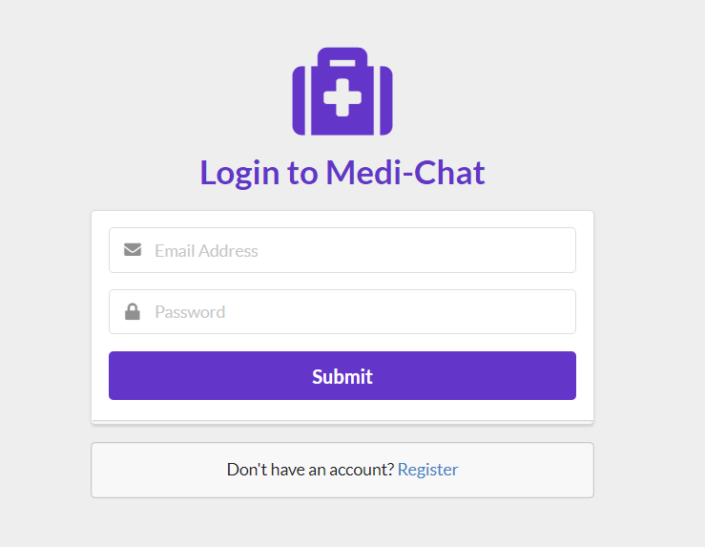
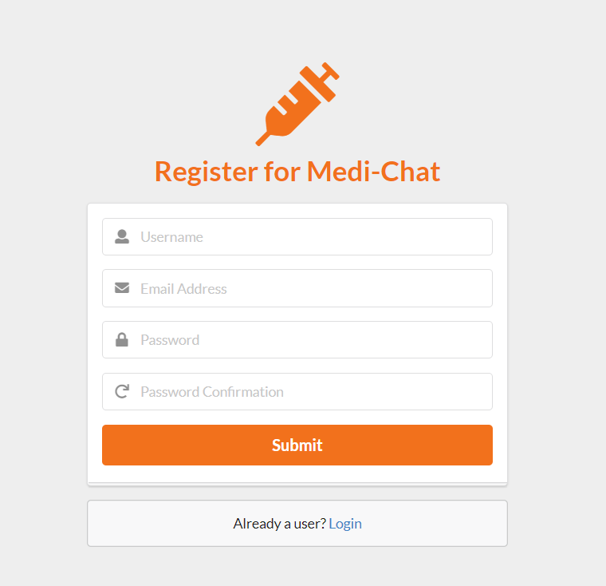
Change UI color Themes comfortable to the eye (for color blind syndrome) in patients. Get notifications in real time.

Slide 18
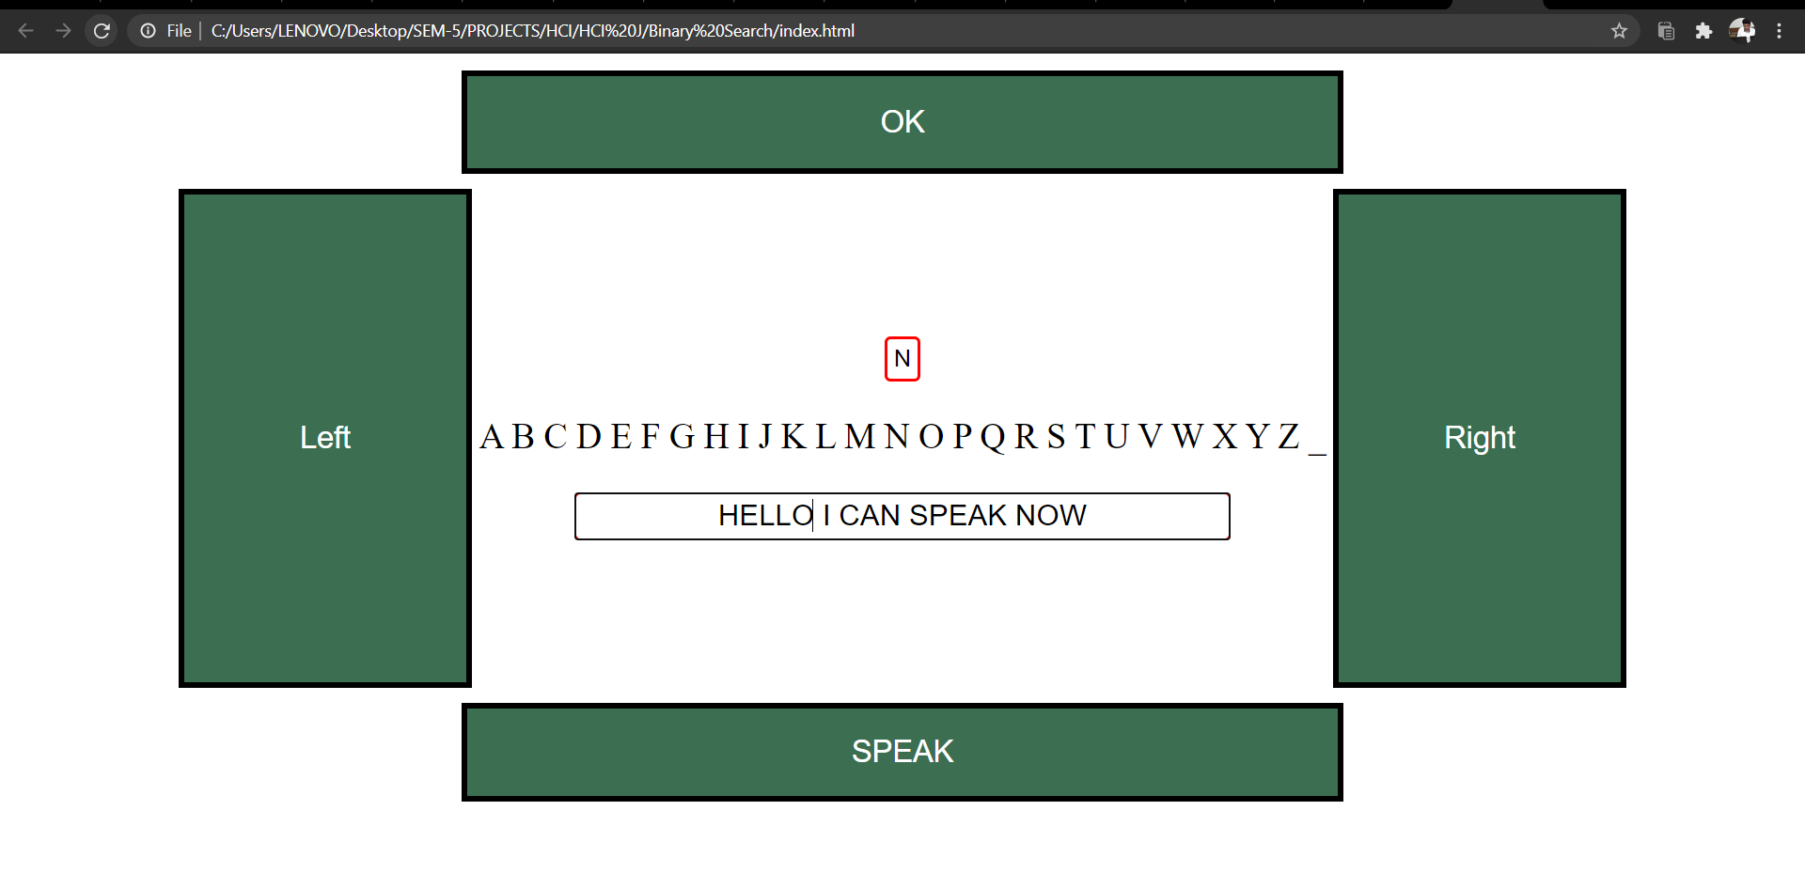
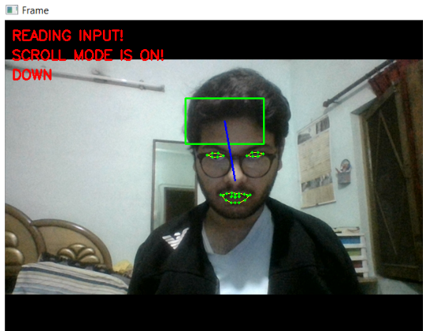
INTERACTIVE EYE CONTROLLED KEYBOARD- USED FOR TEXT TO SPEECH MADE WITH JAVASCRIPT/HTML TO BE INTEGRATED WITH MEDICHAT
Now for this there will be a special type of keyboard which will work in O(log n) time complexity i.e., one word nearly in 4 head movement... something which can be used by people with motor neuron disease too.
The keyboard also works with Speech to Text Feature using Google Speech to Text API
The keyboard can be operated by eye movement to hover and blinking to click.

Slide 19
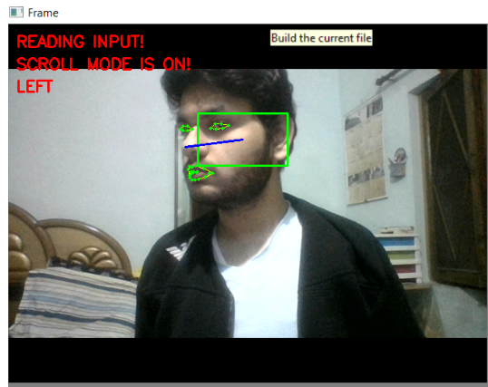
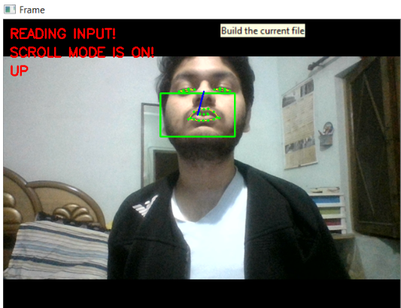
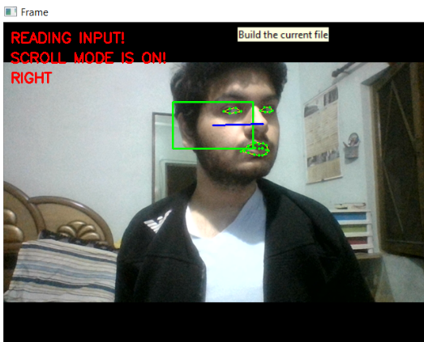
INTERACTIVE EYE CONTROLLED KEYBOARD- USED FOR TEXT TO SPEECH MADE WITH JAVASCRIPT/HTML TO BE INTEGRATED WITH MEDICHAT

Slide 20
What can be done further? What we plan to do with MediChat.
Implementing a news section wherein people get daily updates about trends in medicine, COVID cases by calling an external APIs.
2. Implementing Speech to text NLP engine wherein we can leverage Natural Language Processing techniques and tools like Facebook's Wit.ai to capture the intent of the doctors communicated message and update patient records in the UI in discrete fields like medical prescription, surgery, patient history, along with the timestamp, so that doctors don't face a burnout by having to spend time writing patient records on paper/documents but it can be updated using Speech to Text.

Slide 21
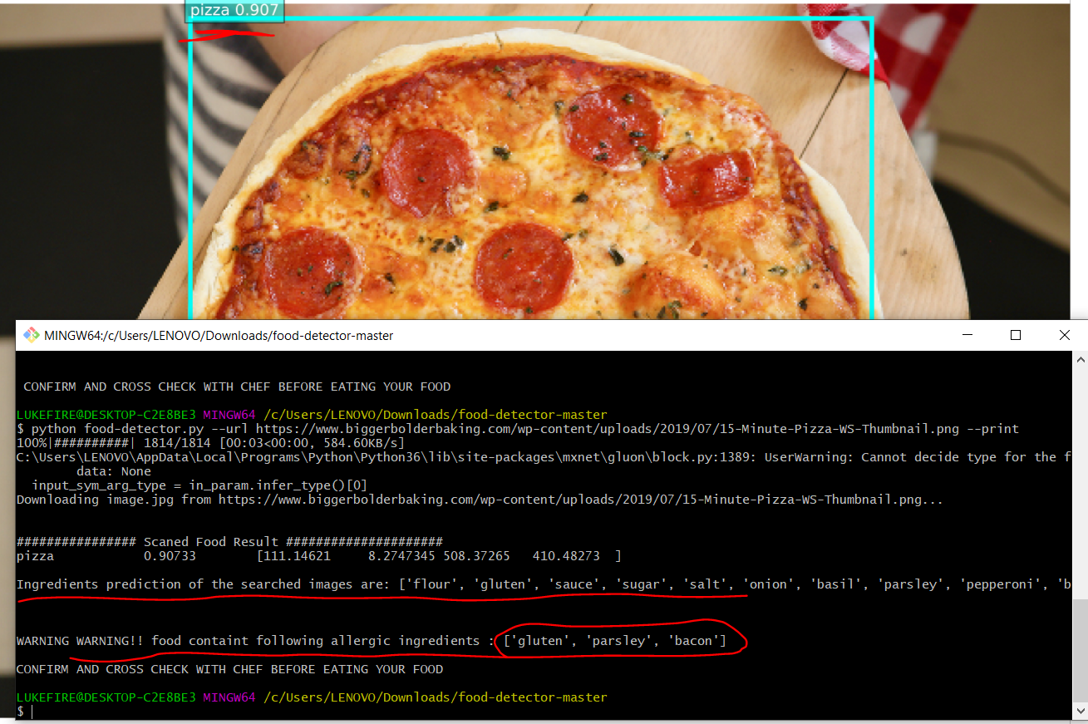
Model to detect allergic ingredients in your food by scanning and identifying the type of food and printing the warning if any.

Slide 22
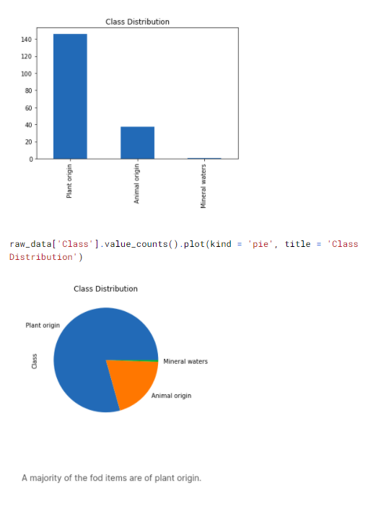
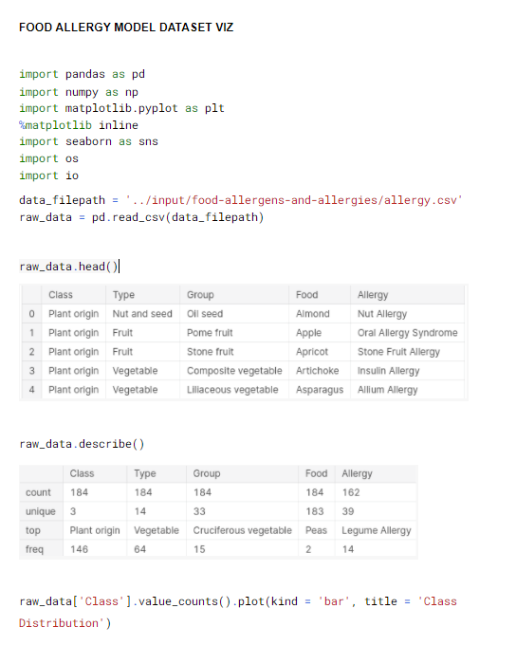
A UNIQUE DATA VIZ FOR FOOD ALLERGY MODEL

Slide 23
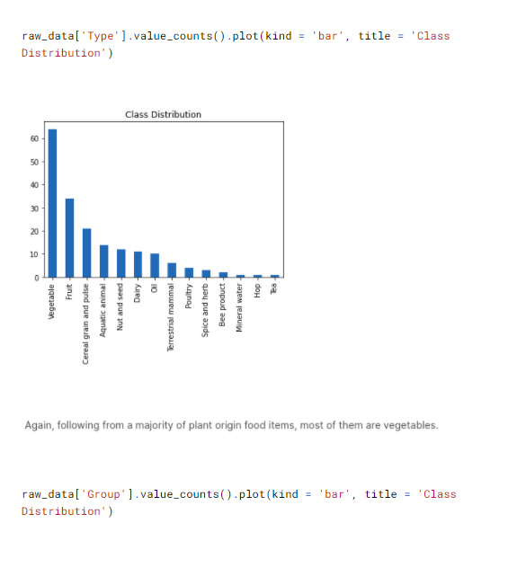
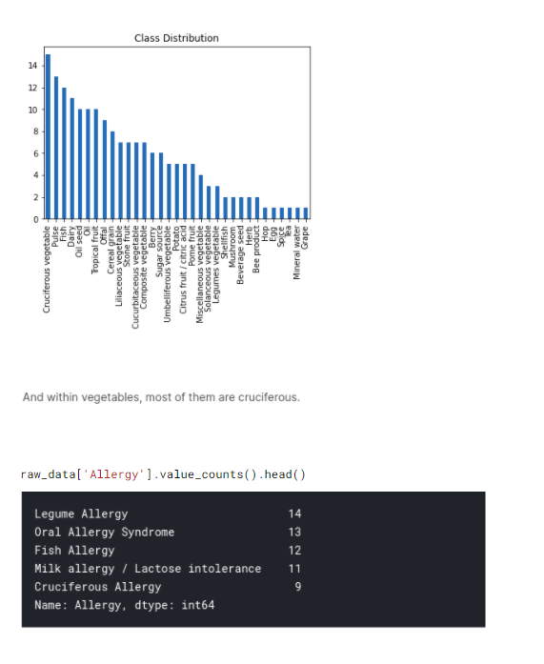

Slide 24
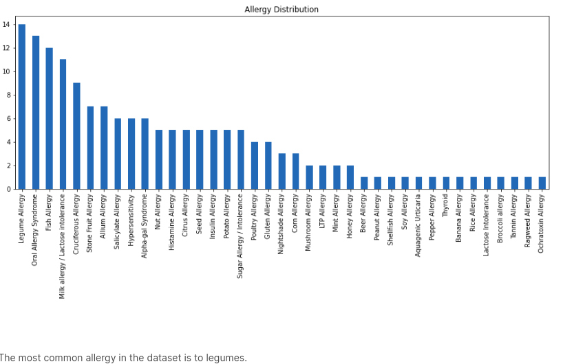
We plotted the allergy distribution and found out that most patients had allergies to Legumes(plant food)

Slide 25
Entity Extraction using Natural Language processing¶
Extracting disease labels from clinical reports
Text matching
Evaluating a labeler
Negation detection
Dependency parsing
Question Answering with BERT
Preprocessing text for input
Extracting features/answers from model output.
What is BERT Language model?
Bidirectional Encoder Representations from Transformers (BERT) is a Transformer-based machine learning technique for natural language processing pre-training developed by Google. BERT was created and published in 2018 by Jacob Devlin and his colleagues from Google

Slide 26
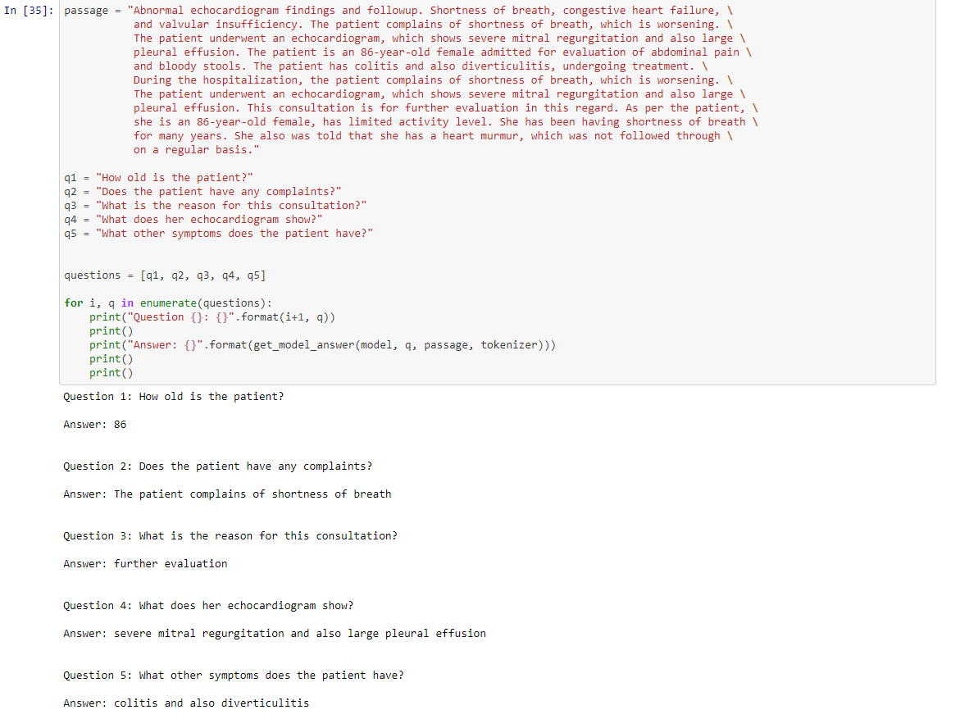

Slide 27
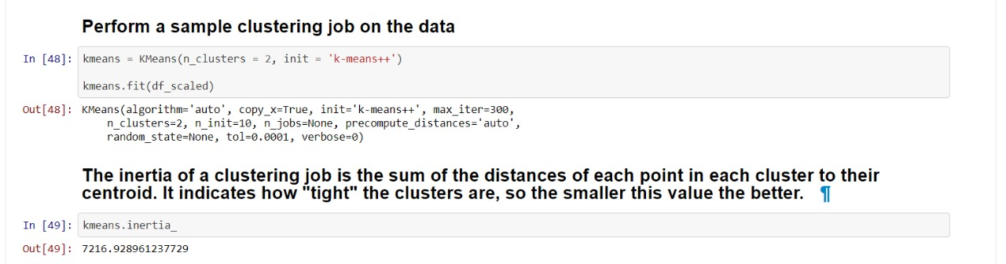
We were provided with Comma separated Value data as part of the challenge. We made a data analysis and visualisation using plots to detect anomalies is person’s bodyweight using clustering algorithms.

Slide 28
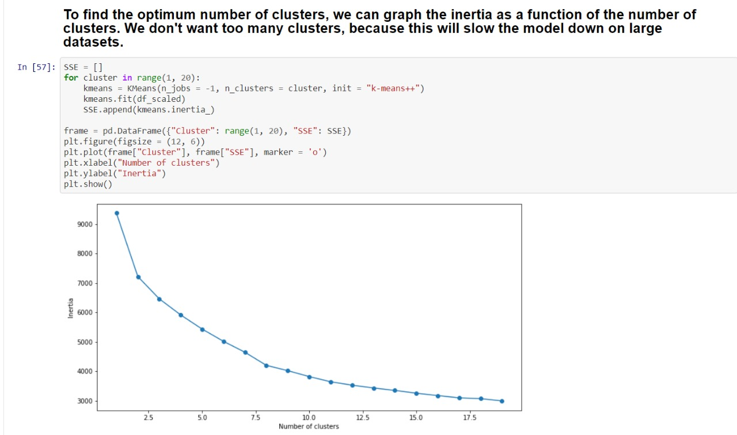
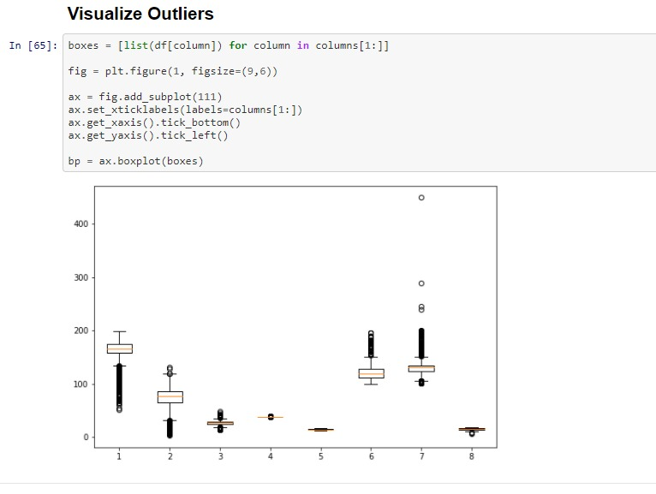

Slide 29
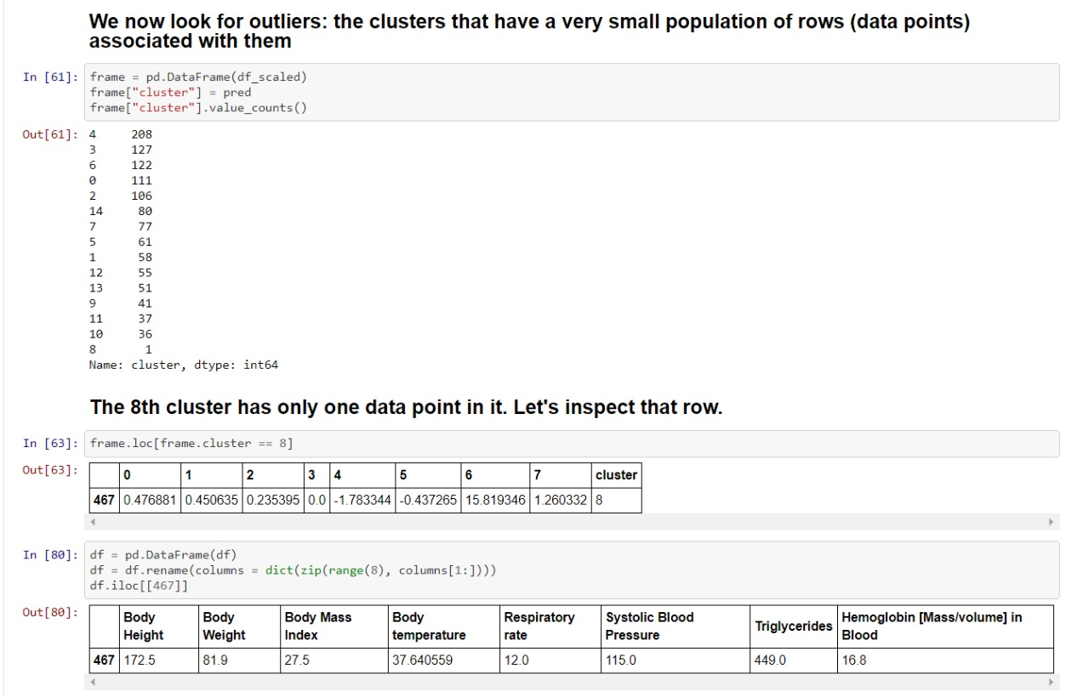

Slide 30
COST
SMALL PC WITH WEBCAM- $170
ROBOCARE APP- FREE OF COST
WEBAPP COST – DOCTORS CONSULTATION FEES ONLY
FOOD ALLERGIC DETECTION SYSTEM INSTALLED IN PC
WHEELCHAIR HAND GESTURE MECHANISM: $71
TOTAL COST OF SYSTEM: $241 (Approx)

Slide 31
THANK YOU

